Slide 1


PRESENTATION
FOR LADIES DEPARTMENT

Slide 2
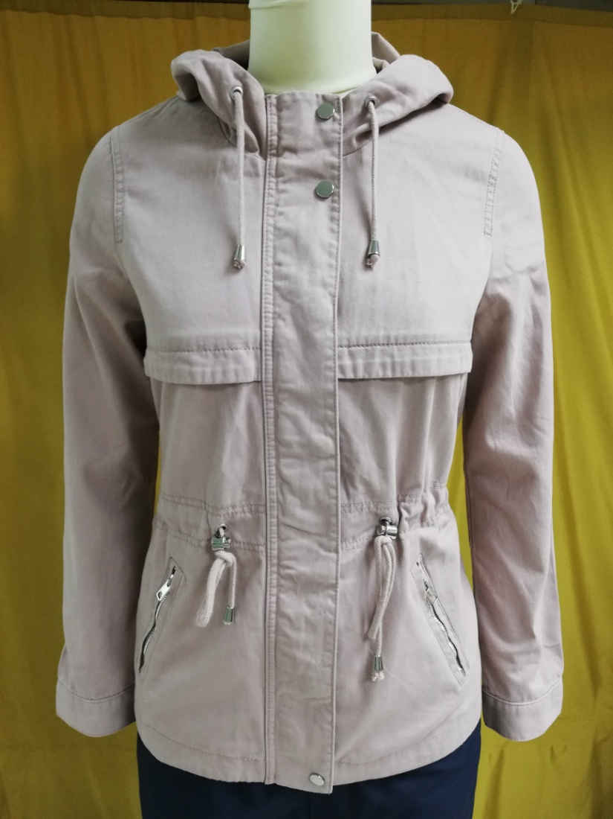
BUYER-H&M
STYLE: Falcon Parka
Shell: 100% Cotton Twill
Fiber filling :N/A
Item : Women's JKT
wash: ENZ
FOB $ : 14.00

Slide 3

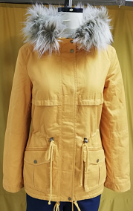
BUYER-H&M
STYLE: Carla Parka
Shell: 100% Cotton Twill
Item : Women's JKT
FOB $ : 16.50
Wash : ENZ

Slide 4
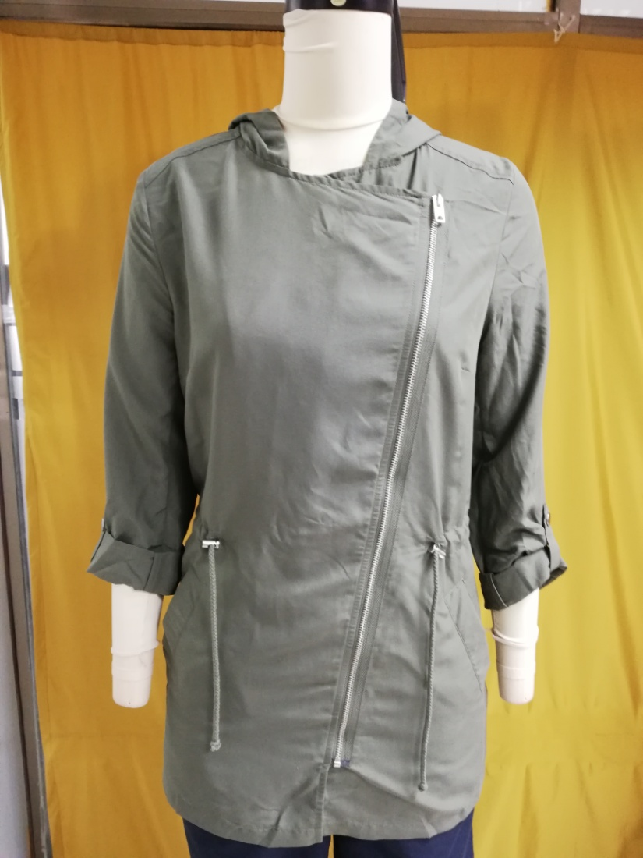
BUYER-H&M
STYLE: Peach Parka
Shell: viscose 72% 28% polyester.
Fiberfill: N/A
Item : Women's JKT
Non wash
FOB $ : 10.50

Slide 5
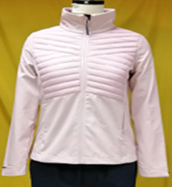
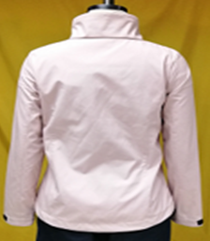
Buyer:OTCF
Style: D4Z19-SFD302 (Women Soft Shell Jacket)
Shell: Body-1: 100 % Polyester Woven Fabric Bonded With 100% Polyester Interlock, Membrane: TPU Lamination Wp 8000/ MVP 6000, DWR Finishing , Body-2:100% Polyamide Full Dull 20D*20D 380T (Matt & DWR Finishing)
Tricot: 100% Polyester Tricot
Padding: 100% Polyester Fake Down
Fob: $ / Pcs.16.70

Slide 6
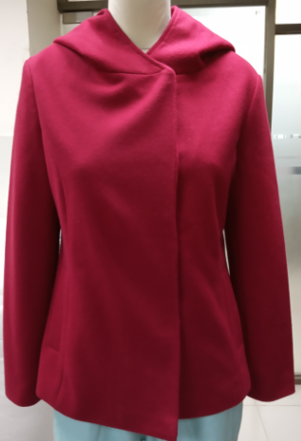
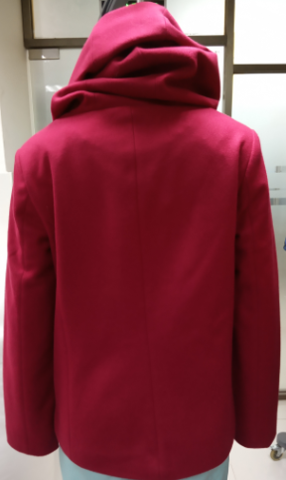
Buyer: C&A
STYLE: Wenka Jacket
Shell: viscose 78% polyester, 11%Rayon,11%Acrle
Lining:100%Polyester 210T
Fiberfill: N/A
Item : Women's JKT
Non wash
FOB $ :15.60

Slide 7

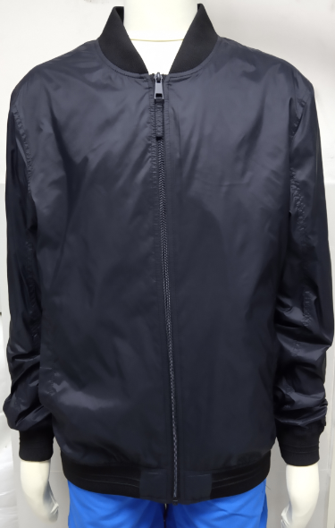
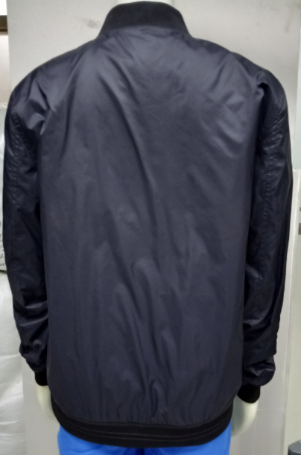
L
BUYER:C&A
FOB:7.60
STYLE:1/2012/01004/001
SHELL FABRIC:100 % NYLON
LINING FABRIC:100 % POLYESTER 210T
TAFFETA
FOB:6.9500

Slide 8
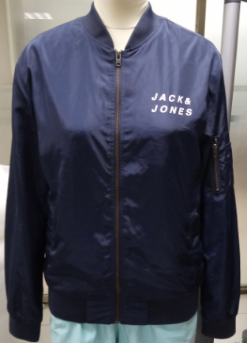
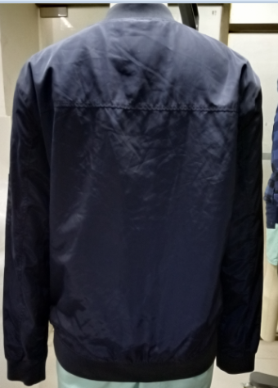
Buyer:Jack & Jones
STYLE: JCOSNIPE
Shell: 100% Cotton Twill
Item : Women's JKT
Enzyme wash
FOB $ : 11.70

Slide 9
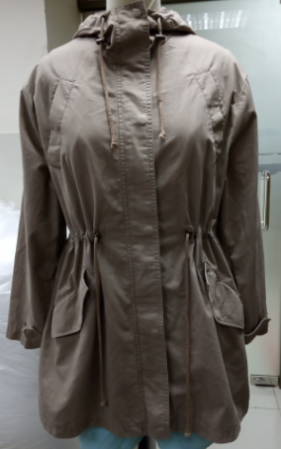
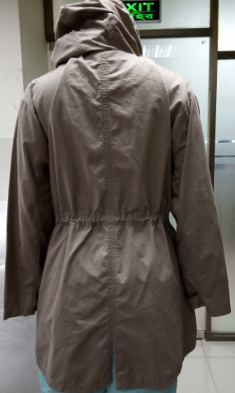
Buyer: KAPPAHL
STYLE:PANDORA JKT
Shell: 100% Cotton
Lining:100% Cotton TC
Item : Women's JKT
Enzyme wash
FOB $ : 13.80

Slide 10
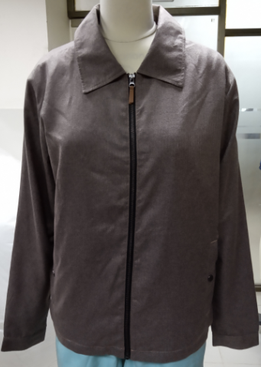
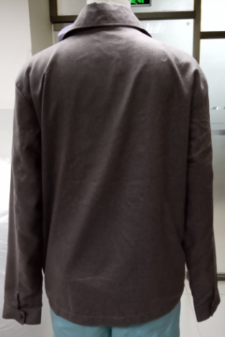
Buyer: C&A
STYLE:19/2/2023/0100415
Shell: 100%Polyester
Lining:100%Polyester 210T AOP
Item : Women's JKT
Enzyme wash
FOB $ :14.41

Slide 11
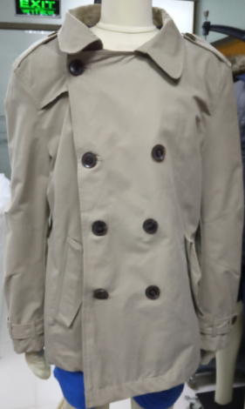
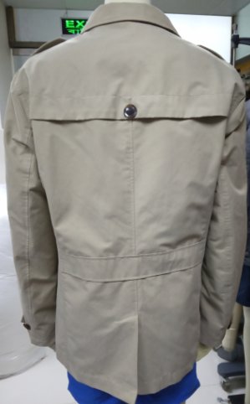
Buyer: TEMA
STYLE:TRENS COAT
Shell: 70% Cotton,30%P[olyester
Item : Women's JKT
WASH
FOB $ :14.00

Slide 12
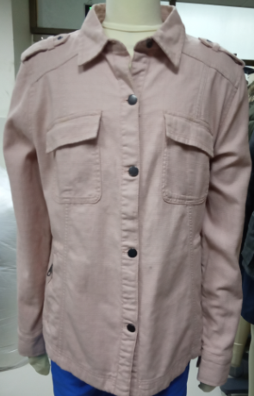
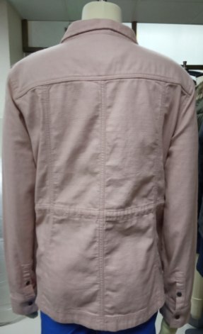
Buyer: NEXT
STYLE:SHIRT JACKET
Shell: 100% Cotton Dobby Strike
Item : Women's JKT
WASH
FOB $ : 16.11

Slide 13
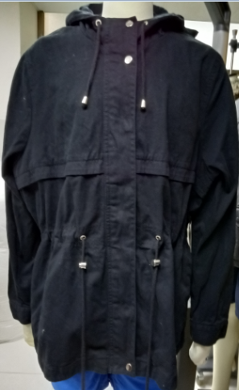
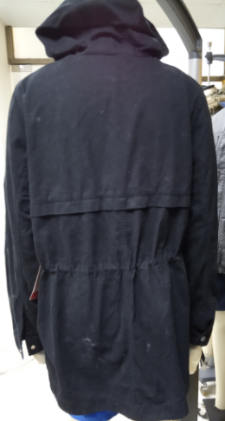
Buyer:TEMA
STYLE:Shail
Shell: 100% Cotton Twill
Item : Women's JKT
WASH
FOB $ :14.00

Slide 14
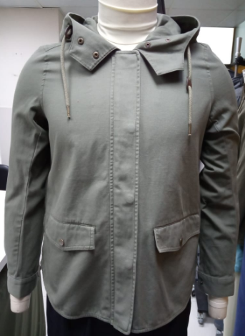
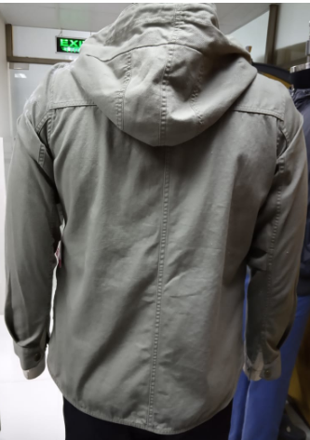
BUYER:H&M
ITEM:LADIES JKT
STYLE:SUE JACKET
FABRIC: 100% Cotton Twill
126x60 , 20x165
FOB:$.12.15

Slide 15
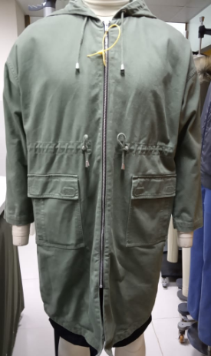
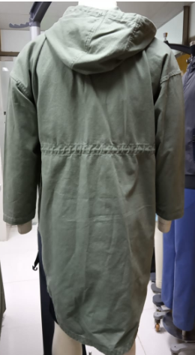
BUYER:C&A
ITEM:LADIES JKT
Style: Melanie Parka
STYLE:100% Cotton Twill
ENZYME WASH.
FOB:$

Slide 16

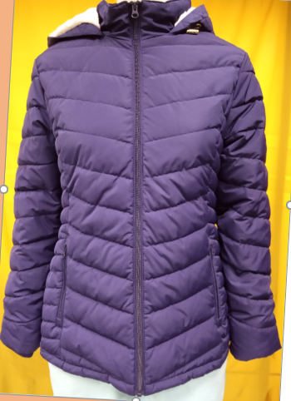
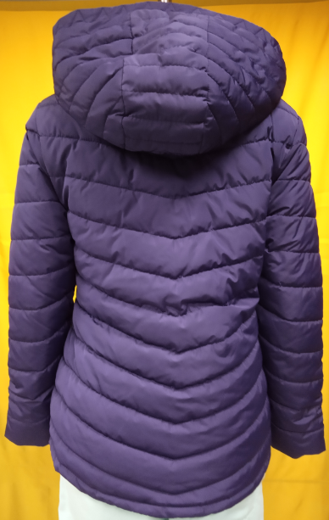
BUYER: WALMART
STYLE:525/5250/0444/002/0011
FABRIC:100% POLYESTER FAKE MEMOROY
PADDING:100% POLYESTER FAKE DOWN
FOB:$14.37

Slide 17

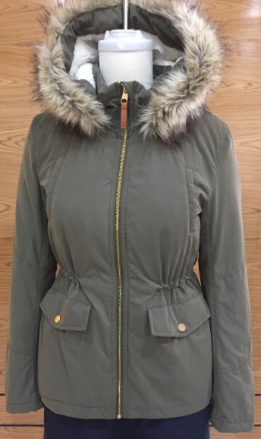
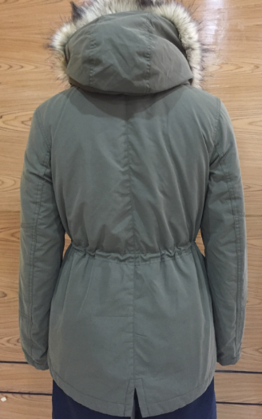
BUYER:H&M
STYLE:Elaine parka
SHELL:88% poly, 12 % BCI cotton
Lining :100% poly 210T
PADDING:S\F 140 padding inside body
FOB:$14.19

Slide 18
BUYER:H&M
STYLE: Carla Parka
Shell: 100% Cotton Twill
FOB $ : 16.50
Wash : ENZ

Slide 19
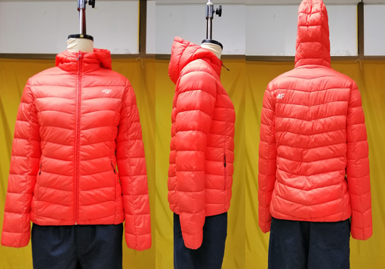
BUYER:OTCF
Style: D4Z19 - KUDP301
FABRIC:100% Polyamide Full Dull 20D*20D 380T (Matt & DWR Finishing)
PADDING:100% Polyester Fake Down
FOB:$

Slide 20
Thank You

